Slide 1

Tours & Travels
Group members with Student Id
Jill Shah-20104004
Swapnil Sawant-20104088
Sushant Waghmare-20104113
Project Guide
Ms. Yaminee.Patil

Slide 2
Contents
Introduction
Objectives
Scope
Proposed System
Project Outcomes
Block Diagram
Use Case/DFD
Technology Stack

Slide 3
1. Introduction
The main purpose of Tour and travels is to provide a best facility and travelling services for a customer to book tickets for trip purpose.
Customers can decide about places they want to visit and make bookings online for travel and accommodation.

Slide 4
2. Objectives
To provides various places to explore according to the travellers.
2.To promote responsible and interesting tourism ,So that the people can enjoy their holiday at their favourable places.
3.To provide reasonable packages and according to their needs also.
4.This system provides Online Registration, Tour Package Information, Train ticket booking.

Slide 5
3. Scope
1. This type of software’s can be further extended for generating reviews related to the tourist requirements.
2. A traveler can find everything related to travelling services under one roof by this website.
3. It is Easy to understand by the users and operator.
4. Easy to find the nearby famous places, book Trains , Hotels , Flights.
5. Provide offers for various places in budgets occasionally.

Slide 6
4. Proposed System
Home Page:
This project contains the basic information about the Travel System.
About Page:
It contains information about our software.
Packages Page:
This page contain all the information of packages.
Contact Page:
User can submit your feedback with details on our website.
Login:
User can login / Create new account / update profile on the website.

Slide 7
5. Outcome of Project
User can easily book or cancel their tours.
User can also select their places for holiday according to their requirement .
User easily book the trains , hotels , flights for the they want to visit.
User can also see the map location of the desired hotel.

Slide 8
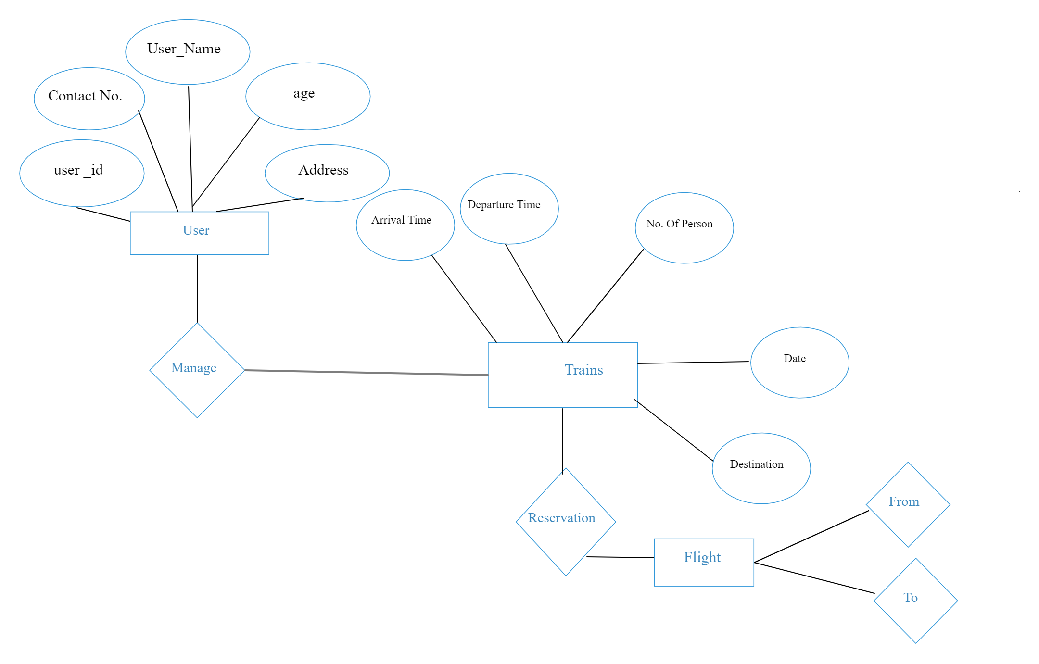
7. Block Diagram

Slide 9




8. Technology Stack
HTML –
Php –
Java Script –
4. CSS -

Slide 10
Thank You...!!

